Slide 1


IS 540 Information Technology Acceptance in Organizations
10 November 2021
ARTICLE PRESENTATION
Perceived Usefulness, Perceived Ease of Use,
and User Acceptance of Information Technology
by Fred D. Davis
Rüstem Ozan Özdemir
1938935
Notes:
Good morning, everyone. I am Ozan Özdemir. Today, I would like to talk about article entitled by Perceived Usefulness, Perceived Ease of Use, and User Acceptance of Information Technology by Fred D. Davis.

Slide 2






01
Introduction
02
Perceived Usefulness and Perceived Ease of Use
03
Scale Development and Pretest
04
Study 1 and Study 2
05
Discussion & Conclusion
Notes:
I organized the sections as follows. My main purpose in this presentation is to explain the article in a way that everyone can understand. Therefore, I will try to define the technical terms in their simplest and understandable form. Now, I can move onto next slide.

Slide 3
Introduction
Introduction
Perceived Usefulness and Perceived Ease of Use
Scale Development and Pretest
Discussion & Conclusion
Study 1 and Study 2
Users’ unwillingness to accept and use available systems
Shortage of high-quality measures
Development of improved measures for key theoretical constructs
Practical value of better measures
Unvalidated measurements
Little attention to quality of the measures used or how well they correlate with usage behavior
Notes:
Information technology has the potential to significantly boost white-collar performance. However, performance gains are frequently hampered by users' unwillingness to accept and use available systems. Despite the fact that numerous individuals, organizational, and technological variables have been studied, research has been constrained by a shortage of high-quality measures for key determinants of user acceptance. Previous research indicates that many measures do not correlate highly with system use, and the size of the usage correlation varies greatly from study to study depending on the specific measures used. The development of measures for key theoretical constructs is a research priority in the field of information systems. Aside from their theoretical value, better measures for predicting and explaining system use would be extremely useful in practice, both for vendors seeking to assess user demand for new design ideas and for information systems managers within user organizations seeking to evaluate these vendor offerings. Unvalidated measurements are now commonly utilized in practice across the board in the design, selection, implementation, and evaluation of projects. Despite the extensive use of subjective measures in practice, the quality of the measures used and how well they correlate with usage behavior receive little attention.

Slide 4
Introduction
Introduction
Perceived Usefulness and Perceived Ease of Use
Scale Development and Pretest
Discussion & Conclusion
Study 1 and Study 2
Purpose
To pursue better measures for predicting and explaining use
Focus
Perceived usefulness
Perceived ease of use
Steps of the study
Emprical studies
New multi-item assessment scales
Correlation and regression analyses
Discussion
Notes:
The purpose of this research is to pursue better measures for predicting and explaining use. The study focuses on two theoretical constructs: perceived usefulness and perceived ease of use, both of which are thought to be important predictors of system use. The theoretical basis for these constructs' hypothesized influence on system use is discussed, as well as their definitions. In two distinct empirical studies, new multi-item assessment scales for perceived usefulness and perceived ease of use are designed, pretested, and validated. The empirical link between the new metrics and self-reported indicants of system use is investigated using correlation and regression analyses. The discussion ends with recommendations for future research.

Slide 5
01
Introduction
Şirketin Kısa Tanıtımı
Hissedarlar
02
Perceived Usefulness and Perceived Ease of Use
03
Scale Development and Pretest
04
Study 1 and Study 2
05
Discussion & Conclusion
Notes:
From now on, I will continue with second section that is Literature Review.

Slide 6

Important Definitions
Introduction
Perceived Usefulness and Perceived Ease of Use
Scale Development and Pretest
Discussion & Conclusion
Study 1 and Study 2
Perceived Usefulness
The degree to which people believe that using a particular system would enhance their job performance
Perceived Ease of Use
The degree to which a person believes that using a particular system would be free of effort.
Notes:
What factors influence whether individuals adopt or reject information technology? Previous study identifies two drivers that are especially important among the various variables that may influence system use. First, people are more likely to use or not use an application if they believe that it would improve their job performance. We refer to this first variable as perceived usefulness. Second, even if potential users believe that a given application is useful, they may also believe that the system is too difficult to use and that the performance benefits of using the application are outweighed by the effort required to use the application. We refer to this second variable as perceived ease of use. In other words, perceived ease of use refers to "the degree to which a person believes that using a particular system would be free of effort".

Slide 7

Theoretical Foundations
Introduction
Perceived Usefulness and Perceived Ease of Use
Scale Development and Pretest
Discussion & Conclusion
Study 1 and Study 2
Schultz and Slevin's exploratory factor analysis
Replication of the exploratory study by Robey
Self-Efficacy theory by Bandura
Cost-Benefit paradigm
Meta-analysis of Tornatzky and Klein on Adoption of Innovations
Evaluation of reports by Larcker and Lessig
Channel disposition model by Swanson
Notes:
Several lines of research indicate the theoretical importance of perceived usefulness and perceived ease of use as determinants of user behavior. Schultz and Slevin's exploratory factor analysis suggested that perceived usefulness influences system utilization. Robey discovers that the performance dimension is most correlated with two objective measures of system usage when using the Schultz and Slevin questionnaire. The importance of perceived ease of use is supported by Bandura's extensive research on self-efficacy, defined as "judgments of how well one can execute courses of action required to deal with prospective situations. The cost-benefit paradigm , behavioral decision theory, is also relevant to perceived usefulness and ease of use. This study explains people's decision-making strategies in terms of a cognitive tradeoff between the effort required to use the strategy and the quality (accuracy) of the resulting decision. According to research on the adoption of innovations, perceived ease of use plays a significant role. According to Tornatzky and Klein, the most consistent significant relationships across a wide range of innovation types are compatibility, relative advantage, and complexity regarding adoption of innovations. Regarding evaluation of reports, previous MIS research on the evaluation of information reports parallels the distinction highlighted above between usefulness and ease of use. Larcker and Lessig factor analyzed six items used to rate four information reports. Swanson introduced and tested model of "channel disposition" for explaining the choice and use of information reports. Perceived usefulness and perceived ease of use have been identified as important and separate characteristics that influence decisions to use information technology from multiple discipline perspectives. To get a better understanding of the nature of perceived usefulness and perceived ease of use, as well as their roles as determinants of computer use, better metrics are required.

Slide 8
01
Introduction
Şirketin Kısa Tanıtımı Proje İçeriği
02
Perceived Usefulness and Perceived Ease of Use
Şirketin Kısa Tanıtımı Proje İçeriği
03
Scale Development and Pretest
04
Study 1 and Study 2
05
Discussion & Conclusion
Notes:
Now, I am going to talk about third section that is Scale Development and Pretest.

Slide 9
Steps of Process and Scale Development
Introduction
Perceived Usefulness and Perceived Ease of Use
Scale Development and Pretest
Discussion & Conclusion
Study 1 and Study 2
Steps of Process
Determination of candidate items
Pretest
Empirical Field Study (Study 1)
Laboratory Study (Study 2)
Scale Development
14 candidate items for each construct
Spearman-Brown Prophecy formula
37 published research articles
Notes:
New multi-item scales with high reliability and validity were developed using a step-by-step procedure. From previous literature, 14 potential items for each construct were generated using the conceptual concepts of perceived usefulness and perceived ease of use. The semantic content of the items was then assessed by pre-test interviews. The objects that best fit the build definitions were kept, resulting in ten elements for each construct. The reliability and construct validity of the generated measures were then assessed in a field study (Study 1) of 112 participants using two separate interactive computer systems. The scales were modified and streamlined to a total of six items per construct. The researchers next conducted a lab study (Study 2) with 40 individuals and two graphics systems. The association between usefulness, ease of use, and self-reported usage was then assessed using data from the two studies. Candidate items for perceived usefulness and perceived ease of use were created using the mentioned conceptual definitions, and then pretested to find the items that best fit the content domains. The number of items to generate for each scale was determined using the Spearman-Brown Prophecy formula. Based on the number of items and reliability of comparable existing scales, this formula calculates the number of items required to attain a certain reliability. Extrapolating from previous research, the formula implies that each perceptual variable would require 10 items to obtain a reliability of at least 0.80. It was chosen to create 14 things for each construct by adding four additional items to allow for item removal. In order to find various aspects of the constructs that should be measured, 37 published research articles dealing with user reactions to interactive systems were analyzed in order to prepare candidate items.

Slide 10
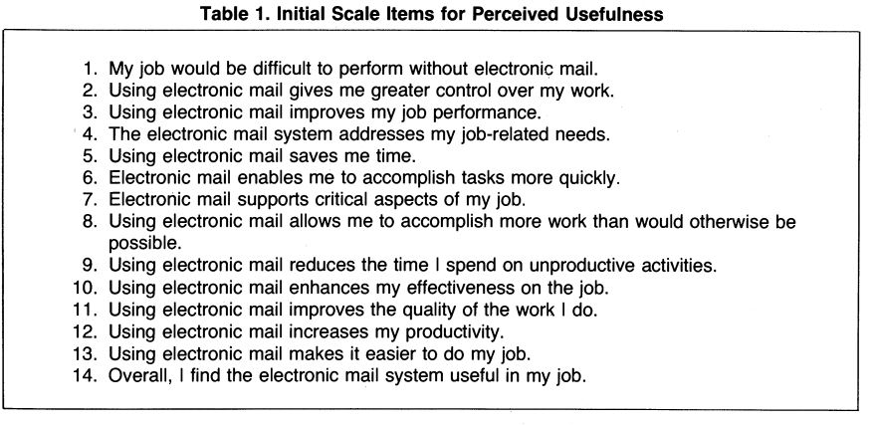
Steps of Process and Scale Development
Introduction
Perceived Usefulness and Perceived Ease of Use
Scale Development and Pretest
Discussion & Conclusion
Study 1 and Study 2
Notes:
The initial item pools for perceived usefulness is given in Table 1.

Slide 11
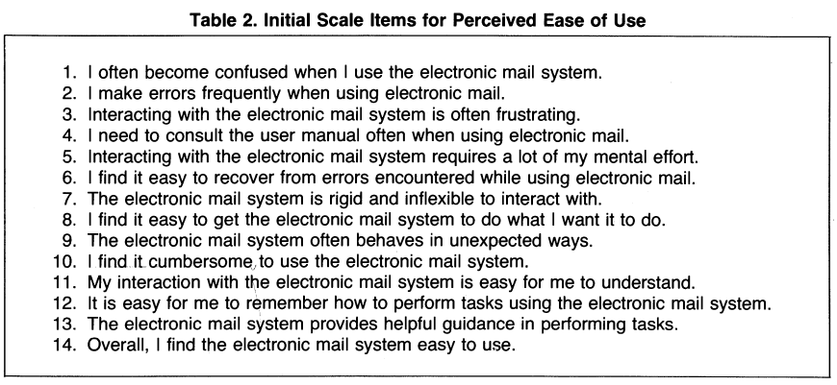
Steps of Process and Scale Development
Introduction
Perceived Usefulness and Perceived Ease of Use
Scale Development and Pretest
Discussion & Conclusion
Study 1 and Study 2
Notes:
The initial item pool for perceived ease of use is given in Table 2.

Slide 12
Pretest
Introduction
Perceived Usefulness and Perceived Ease of Use
Scale Development and Pretest
Discussion & Conclusion
Study 1 and Study 2
To enhance the content validity
Pretest Interviews
15 experienced computer users
Performing Two Tasks
Prioritization
Categorization
Notes:
To improve content validity, pretest interviews were conducted by evaluating the relationship between candidate items and the definitions of the variables they were to measure. Those that don't accurately represent the content of a construct can be screened out by asking people to rank how closely each item meets the variable's definition, and then removing items with low rankings. In eliminating items, we want to make sure not to reduce the representativeness of the item pools. A group of 15 experienced computer users from MIT's Sloan School of Management, comprising five secretaries, five graduate students, and five members of the professional staff, took part in the pretest. Participants were asked to complete two tasks in face-to-face interviews: prioritization and categorization, which were done separately for usefulness and ease of use. For prioritization, they were handed a card providing the definition of the target construct and asked to read it. Then, they were given 13 index cards, each with one of the construct's items printed on them. Each construct's 14th or "overall" item was deleted since its language was nearly identical to the label on the definition card. The 13 cards were ranked by the participants based on how well the meaning of each statement met the stated criterion of ease of use or utility. For categorization, participants were instructed to sort the 13 cards into three to five groups, with the statements within each category being the most similar in meaning to each other and the statements in other categories being the most distinct in meaning.

Slide 13
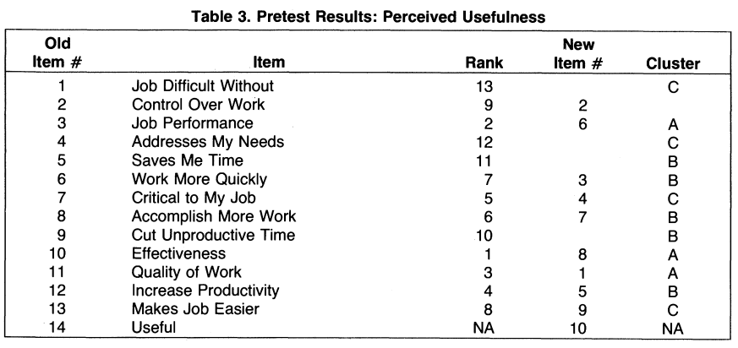
Pretest
Introduction
Perceived Usefulness and Perceived Ease of Use
Scale Development and Pretest
Discussion & Conclusion
Study 1 and Study 2
Notes:
For usefulness, the resulting rank and cluster data are summarized in Tables 3. For perceived usefulness, notice that items fall into three main clusters. The first cluster relates to job effectiveness, the second to productivity and time savings, and the third to the importance of the system to one's job. When the lowest-ranking items (items 1, 4, 5, and 9) are removed, we can see that each of the three primary clusters has at least two items. Item 2, "control over work," was kept because, despite its low ranking, it was in the top 9 and may tap into an important feature of usefulness.

Slide 14
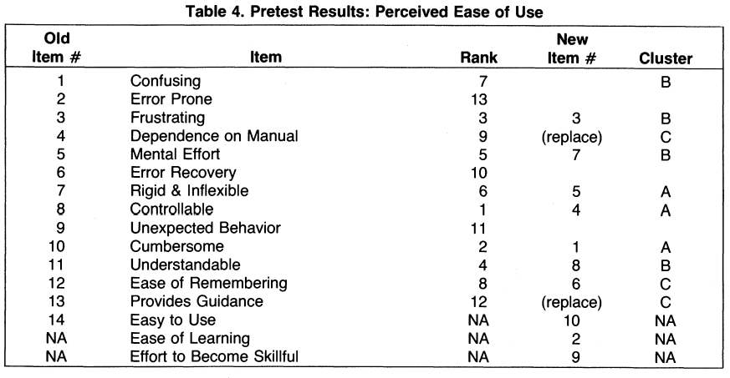
Pretest
Introduction
Perceived Usefulness and Perceived Ease of Use
Scale Development and Pretest
Discussion & Conclusion
Study 1 and Study 2
Notes:
When it comes to perceived ease of use, there are three distinct groups. The first is concerned with physical exertion, whereas the second is concerned with mental exertion. The six highest-priority items are chosen, and the seventh is removed, resulting in good coverage of these two clusters. The third cluster is a little harder to interpret, but it appears to be based on how simple a system is to learn. In this study, ease of learning is treated as a substratum of the ease-of-use construct rather than a separate construct. Because items 4 and 13 provide an indirect assessment of learning ease, they were changed with two items that are more direct: "Learning to operate the electronic mail system is easy for me," and "I find it takes a lot of work to become skilled at using electronic mail". Items 2, 6, and 9 were removed because they did not cluster with other items and had poor priority rankings, implying that they did not fit well within the content domain for ease of use. when combined with the "overall" items for each construct, this procedure provided a 10-item scale for each construct that could be experimentally validated for construct validity and reliability.

Slide 15
01
Introduction
Şirketin Kısa Tanıtımı Proje İçeriği
02
Perceived Usefulness and Perceived Ease of Use
Şirketin Kısa Tanıtımı Proje İçeriği
03
Scale Development and Pretest
Şirketin Kısa Tanıtımı Proje İçeriği
04
Study 1 and Study 2
05
Discussion & Conclusion
Notes:
Next section I am going to talk about is Study 1 and Study 2.

Slide 16

Study 2
Introduction
Perceived Usefulness and Perceived Ease of Use
Scale Development and Pretest
Study 1 and Study 2
Discussion & Conclusion
To assess the reliability, convergent validity, discriminant validity, and factorial validity of the 10-item scales resulting from the pretest
A sample of 120 users within IBM Canada’s Toronto Development Laboratory
Two familiar systems
PROFS electronic mail
XEDIT file editor
7 Point Likert Scale
Reliability and Validity
Multitrait multi-method analysis
Factor Analysis
Scale Refinement
Six-position categorial scales
Relationship to use
Notes:
Study 1, a field study, was conducted to assess the reliability, convergent validity, discriminant validity, and factorial validity of the 10-item scales resulting from the pretest. A questionnaire was issued to 120 users at IBM Canada's Toronto Development Laboratory, asking them to judge the usefulness and ease of use of two systems: PROFS electronic mail and the XEDIT file editor. The PROFS electronic mail system is a basic but limited messaging system for sending short messages. On IBM systems, the XEDIT editor is widely available and supports both full-screen and command-driven editing. Participants were asked to circle a number between one and seven to indicate how much they agreed with each statement. The perceived usefulness scale attained Cronbach alpha reliability of 0.97 for both the electronic mail and XEDIT systems, while perceived ease of use achieved a reliability of 0.86 for electronic mail and 0.93 for XEDIT. When observations were pooled for the two systems, alpha was .97 for usefulness and 0.91 for ease of use. Multitrait-multimethod (MTMM) analysis was used to examine convergent and discriminant validity. The intercorrelations of items (methods) applied to the two different test systems, electronic mail and XEDIT, are contained in the MTMM matrix. Thanks to MTMM analysis, data supports the convergent validity of the two scales. Moreover, the MTMM analysis supported the ability of the 10-item scales for each construct to differentiate between systems. Factorial validity is concerned with whether the usefulness and ease of use items form distinct constructs. The results show that the usefulness and ease of use items load on distinct factor. The construct validity of the 10-item measures is supported by multitrait-multimethod analysis and factor analysis. Regarding scale refinement, Based on the results of the field study, six of the 10 items for each construct were selected to form modified scales. The regression and partial correlation results indicate that usefulness mediates the effect of ease of use on usage, implying that ease of use indirectly influences usage through its effect on usefulness.

Slide 17
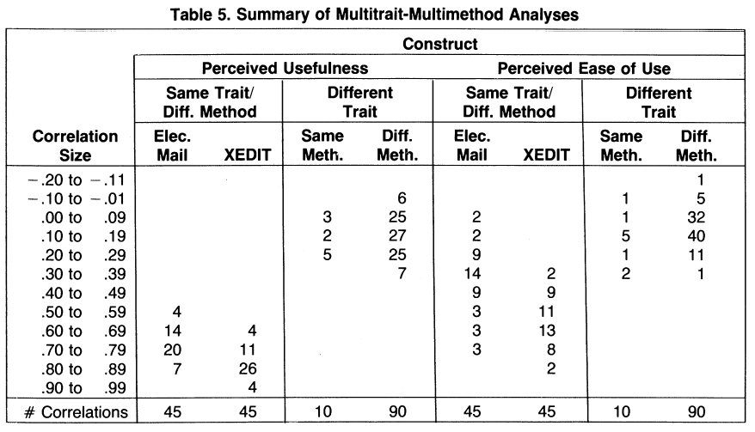
Study 1
Introduction
Perceived Usefulness and Perceived Ease of Use
Scale Development and Pretest
Study 1 and Study 2
Discussion & Conclusion
Notes:
The summary of Multitrait-Multimethod Analyses can be seen as follows.

Slide 18
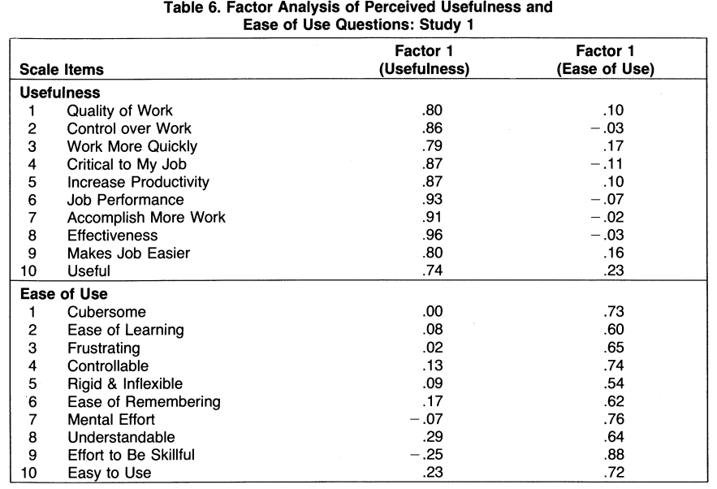
Study 1
Introduction
Perceived Usefulness and Perceived Ease of Use
Scale Development and Pretest
Study 1 and Study 2
Discussion & Conclusion
Notes:
Also, the Factor analysis can be seen as follows.

Slide 19
Study 2
Introduction
Perceived Usefulness and Perceived Ease of Use
Scale Development and Pretest
Study 1 and Study 2
Discussion & Conclusion
40 participants
Two unfamiliar systems
Chart Master
Pendraw
Reliability and Validity
Relationship to use
2 seven-point scale
Regression and partial correlation results
Notes:
A lab study was performed to evaluate the sixitem usefulness and ease of use scales resulting from scale refinement in Study 1. Study 2 was created to simulate a situation where a prototype was being tested or a system was being chosen. The lab study involved 40 voluntary participants who were evening MBA students at Boston University. Moreover, participants are unfamiliar with the two systems used in the study. The study involved evaluating two IBM graphics systems: Chart-Master and Pendraw. ChartMaster is a menu-driven package that creates numerical business graphs on parameters defined by the user. Pendraw uses bit-mapped graphics and a "direct manipulation" interface where users draw desired shapes using a digitizer tablet and an electronic "pen" as a stylus. Participants were given one hour of hands-on experience with Chart-Master and Pendraw. Regarding reliability and validity, Cronbach alpha was .98 for perceived usefulness and .94 for perceived ease of use. Convergent validity was supported. As in Study 1, Study 2 provides favorably on the convergent, discriminant, and factorial validity of the usefulness and ease of use scales. Regarding relationship to use, Participants were asked to self-predict their future use of Chart-Master and Pendraw by using two seven-point scales, one with likely-unlikely end-point adjectives, the other, with improbable-probable endpoint adjectives. Furthermore, when usefulness is controlled for, the significant pairwise correlations between ease of use and usefulness decline dramatically, implying that ease of use functions through usefulness. These regression and partial correlation results, like those in Study 1, show that usefulness mediates the influence of ease of use on usage.

Slide 20
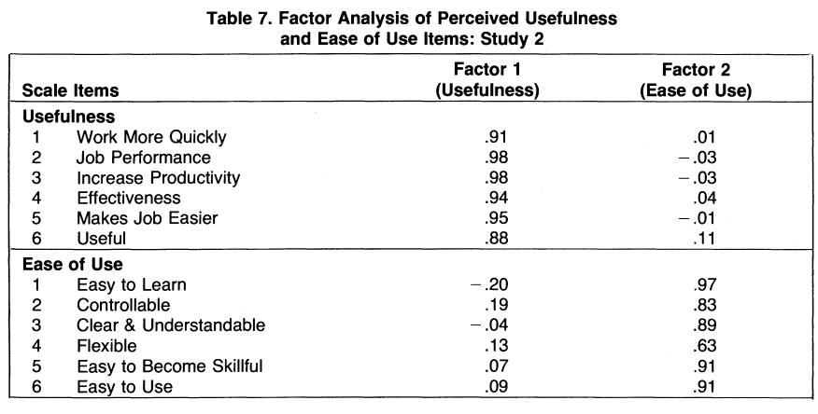
Study 2
Introduction
Perceived Usefulness and Perceived Ease of Use
Scale Development and Pretest
Study 1 and Study 2
Discussion & Conclusion
Notes:
The results of Study 2 including factor analysis, correlation analysis and regression analysis can be seen as follows.

Slide 21
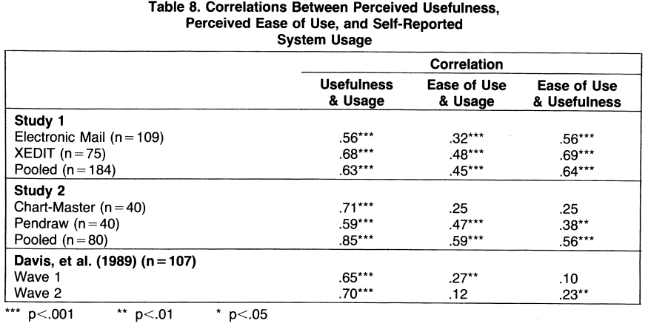
Study 2
Introduction
Perceived Usefulness and Perceived Ease of Use
Scale Development and Pretest
Study 1 and Study 2
Discussion & Conclusion
Notes:
The results of Study 2 including factor analysis, correlation analysis and regression analysis can be seen as follows.

Slide 22
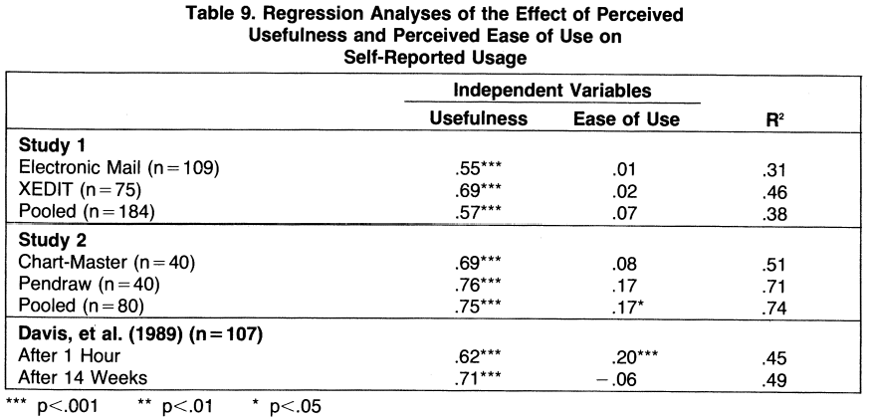
Study 2
Introduction
Perceived Usefulness and Perceived Ease of Use
Scale Development and Pretest
Study 1 and Study 2
Discussion & Conclusion
Notes:
The results of Study 2 including factor analysis, correlation analysis and regression analysis can be seen as follows.

Slide 23
01
Introduction
Şirketin Kısa Tanıtımı Proje İçeriği
02
Perceived Usefulness and Perceived Ease of Use
Şirketin Kısa Tanıtımı Proje İçeriği
03
Scale Development and Pretest
Şirketin Kısa Tanıtımı Proje İçeriği
04
Study 1 and Study 2
05
Discussion & Conclusion
Notes:
The last section of my presentation is Discussion & Conclusion.

Slide 24
Discussion
Introduction
Perceived Usefulness and Perceived Ease of Use
Scale Development and Pretest
Discussion & Conclusion
Study 1 and Study 2
Strong psychometric properties
Psychometric strength of the new measurement scales
Strong correlation of perceived usefulness and user acceptance
Causal perspective
Notes:
The goal of this research was to create and verify new measurement scales for perceived usefulness and ease of use. The new scales were discovered to have high psychometric qualities as well as significant empirical connections with self-reported usage behavior measures. The new scales provide excellent psychometric characteristics. Convergent and discriminant validity were strongly supported by multitrait-multimethod analyses in both validation studies. These two data sets also provided strong support for factorial validity. Cronbach alpha reliability for perceived usefulness was 0.97 in Study 1 and 0.98 in Study 2. Reliability for ease of use was 0.91 in Study 1 and 0.94 in Study 2. These findings mutually confirm the psychometric strength of the new measurement scales. a major conclusion of this study is that perceived usefulness is a strong correlate of user acceptance and should not be ignored by those attempting to design or implement successful systems. From a causal perspective, When usefulness is controlled for, the significant pairwise link between ease of use and usage almost vanishes. The regression results suggest that ease of use may be an antecedent to usefulness, rather than a parallel, direct determinant of usage.

Slide 25
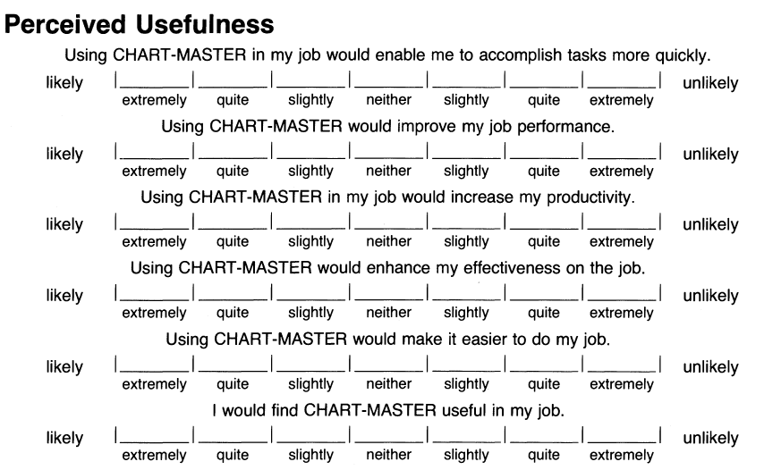
Final Scales
Introduction
Perceived Usefulness and Perceived Ease of Use
Scale Development and Pretest
Discussion & Conclusion
Study 1 and Study 2
Notes:
Final measurement scales for perceived usefulness and perceived ease of use can be seen as follows.

Slide 26
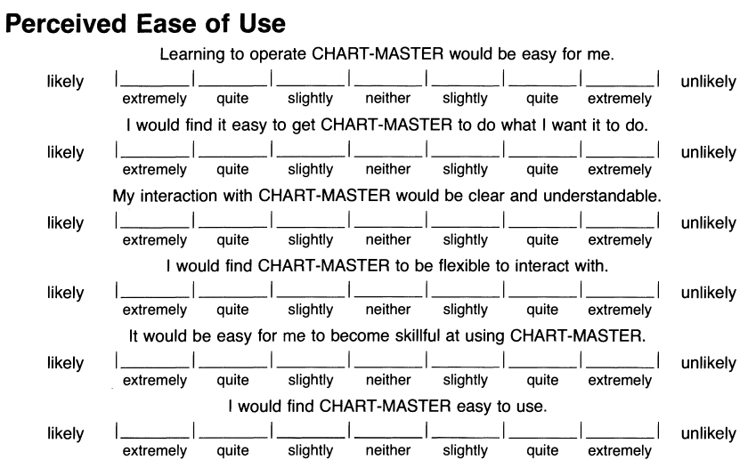
Final Scales
Introduction
Perceived Usefulness and Perceived Ease of Use
Scale Development and Pretest
Discussion & Conclusion
Study 1 and Study 2
Notes:
Final measurement scales for perceived usefulness and perceived ease of use can be seen as follows.

Slide 27
THANKS
Notes:
Thank you for your attention.

